Slide 1
SALES COMPANY
DATA ANALYSIS AND BUSINESS ANALYSIS PROJECT DONE BY
ONANIKE SAMUEL CHISOM

Slide 2
ABOUT THE COMPANY
The sales company is based in Pakistan and india and focuses mostly on the sales of agricultural products. The business employs a team of salespeople that make sales to various customers in various cities. The business entered into a deal with a shipping company so that they could deliver the products that customers ordered in accordance with their locations. Because different customers prefer different payment methods, the sales organization accepts a variety of payment methods.

Slide 3
BUSINESS OJECTIVES and PROBLEM STATEMENT
Market Coverage
Customer Focus
Product Focus
Sales Force Capability

Slide 4
LIST OF THE PRODUCT SOLD
Beverages
Baked Goods and Mixes
Soups
Candy
Dried Fruit and Nut
Condiment
Canned Meat
Dairy product
Grains
Jam Preserves
Sauce
Pasta
Oil
Fruit & veg

Slide 5
LIST OF SALESPERSONS
Kamran Ahmed
Ahmed Ali
Tausif Ali
Shahid Raza
Salim Kanchwala
Munir Nizar
Muhammad Raza
Salman Shah

Slide 6
SQL INSIGHTS
SQL SERVER IS MYSQL

Slide 7
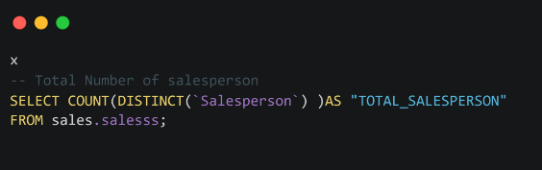
SQL INSIGHTS
The total number of salespersons
SQL CODE

Slide 8

SQL INSIGHTS
RESULTS

Slide 9
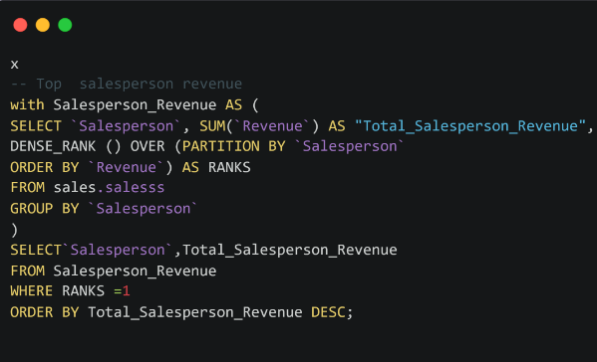
SQL INSIGHTS
Total salespersons revenue

Slide 10
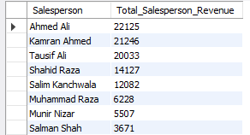
SQL INSIGHTS
RESULTS

Slide 11
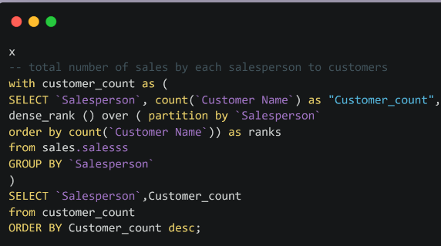
SQL INSIGHTS
Customers overall to each salesperson

Slide 12
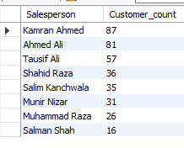
SQL INSIGHTS
RESULTS

Slide 13
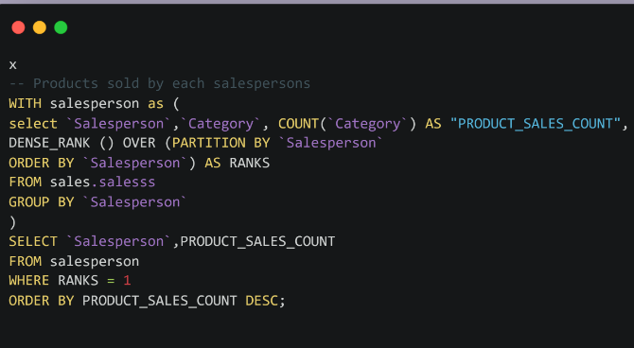
SQL INSIGHTS
Total number of products each salesperson sold

Slide 14
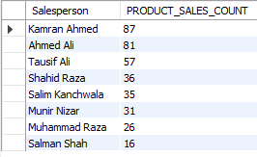
SQL INSIGHTS
RESULTS

Slide 15
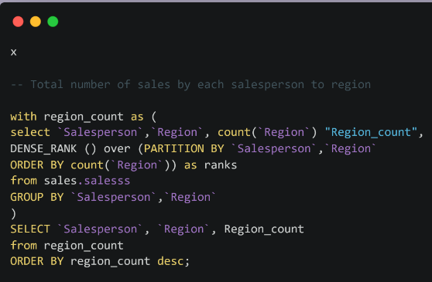
SQL INSIGHTS
Total salespersons and total sales in each region

Slide 16
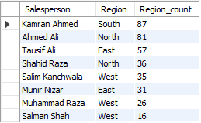
SQL INSIGHTS
RESULTS

Slide 17
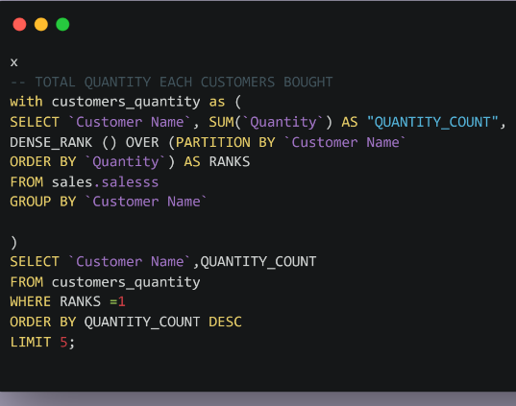
SQL INSIGHTS
Top 5 Quantity bought by each customer

Slide 18
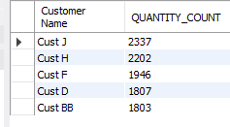
SQL INSIGHTS
RESULTS

Slide 19
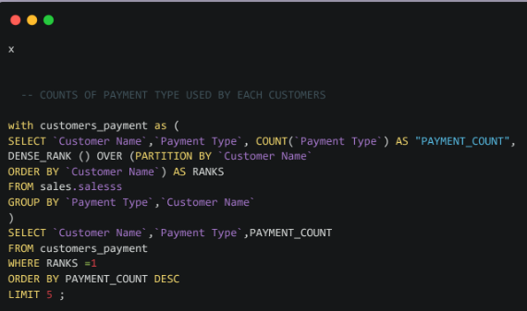
SQL INSIGHTS
Top 5 customers and all payment systems

Slide 20
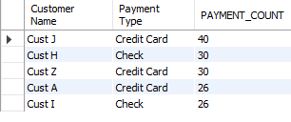
SQL INSIGHTS
RESULTS

Slide 21
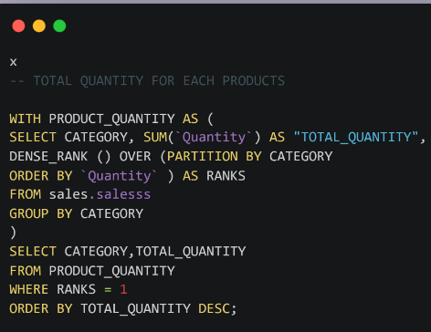
SQL INSIGHTS
Total quantity for each products

Slide 22
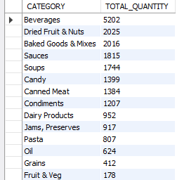
SQL INSIGHTS
RESULTS

Slide 23
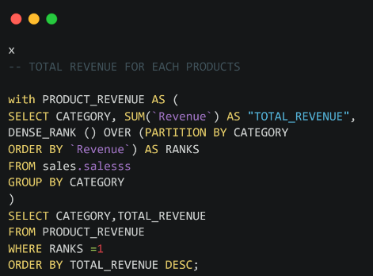
SQL INSIGHTS
Total revenue for each products

Slide 24
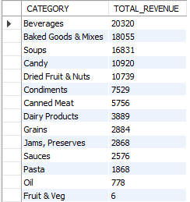
SQL INSIGHTS
RESULTS

Slide 25
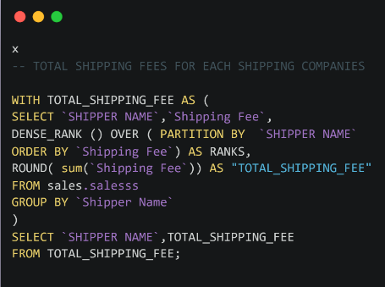
SQL INSIGHTS
Top shipping fees for each shipping companies

Slide 26

SQL INSIGHTS
RESULTS

Slide 27
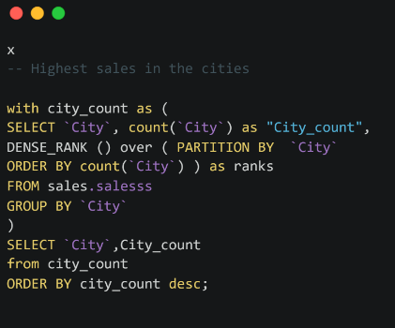
SQL INSIGHTS
Total sales in each cities

Slide 28
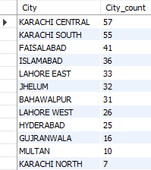
SQL INSIGHTS
RESULTS

Slide 29
BUSINESS INSIGHTS
The sales company needs the business analyst team to make the best choice from the problem statements in order to know how to address the Market Coverage , Customer Focus , Product Focus , and Sales Force Capacity.

Slide 30
BUSINESS INSIGHTS
MARKET COVERAGE STRATEGY
Market Coverage Strategy: is the act of analyzing the market to determine how much of the overall market your advertising campaign should cover for a particular good or service.

Slide 31
BUSINESS INSIGHTS
The business analyst team evaluated every form of marketing coverage strategy available before settling on the Undifferentiated Marketing.
What is Undifferentiated Marketing?
Undifferentiated Marketing or Mass-Marketing is a technique, which treats the entire market as a single entity.

Slide 32
BUSINESS INSIGHTS
The sales company must make improvements on
Their productions, distribution, inventory, and transportation, advertisment , and marketing.

Slide 33
BUSINESS INSIGHTS
The business analyst team has chosen to concentrate on Customer Focus Strategies so that we may fully understand the suggestions and opinions of the customers regarding the products.
Customer Focus Strategies: Places the needs of customers at the forefront of all corporate decisions.

Slide 34
BUSINESS INSIGHTS
The business analyst team has chosen to provide the sales company with a list of some approaches to increase their customer focus.
Create a means of getting feedbacks, actions, and behaviors from customers.
Create a team that can understand the awareness of global issues surrounding sales of agricultural products.
Create a whole company support as a way to get every employee talking to customers after some training.
Create a customer newsletter that shares customers stories and reviews.

Slide 35
BUSINESS INSIGHTS
In order to identify any methods for enhancing and improving products in the sales company, the business analyst team has chosen to investigate the products and choose a product focus.
Product Focus Strategies: is frequently utilized to manufacture , enhance , and improve the present products rather than concentrating on the new ones.

Slide 36
BUSINESS INSIGHTS
The business analyst team has chosen to provide the sales company with a list of some approaches to increase their Product Focus
Focus on the low revenue products and improve the quality.
Improve on the high revenue products and make the price to be very affordable for customers to win over competitors.

Slide 37
BUSINESS INSIGHTS
The business analyst team looked into the sales force at the sales company and discovered that the majority of salespeople are not truly closing deals. In order to ensure that the sales company can increase its sales , the team chose to concentrate on the competency of the sales force.
Sales Force Capability determines the effectiveness of a sales team to close deals.

Slide 38
BUSINESS INSIGHTS
The business analyst team provided a remedy for the inadequate product sales in the sales company
Create a training system that trains the salesperson, to acquire more skills and strategies
Allocate mentorships and coaches to each salesperson

Slide 39
CONCLUSION
The sales company has placed a strong emphasis on increasing their sales, and our team has concentrated on the key areas that the company has identified. We have worked tirelessly with the data to gain the necessary insight and understanding, and we have identified solutions for each problem. In order to make the company hit a high trend in the market , the solutions described above are the best course of action.

